Slide 1
Chapter 12: Introduction to Electricity Markets

Slide 2
Traditional electric utility model
Generation
Monopoly
Only supplier of electricity in a region
“service territory”
Consumer does not have a choice of supplier
Vertically integrated
A single organization performs all the technical and business functions
Transmission
Distribution
Retail
Consumer

Slide 3
Why vertical integration?
Generation
Used to be considered more efficient
Issues:
Lack of transparency
Poor internal communication in very large organizations
Transmission
Distribution
Retail
Consumer

Slide 4
Why monopolies?
Building a power system is expensive
Building competing transmission and distribution networks does not make sense
“Natural Monopoly”
Until recently having several companies “share” a power system was too complicated
Monopoly can be:
Private (investor-owned utility)
Public (municipal, utility district, national)
Size of service territories varies

Slide 5
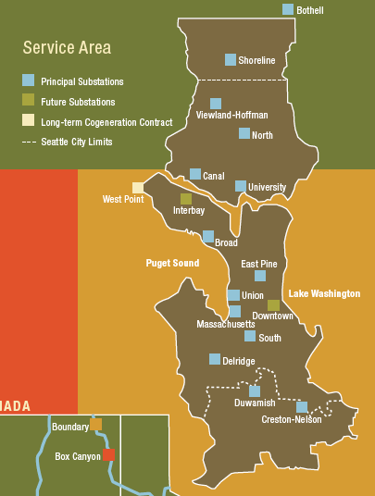
Example 1: Seattle City Light
Owned by the City of Seattle
Public monopoly

Slide 6
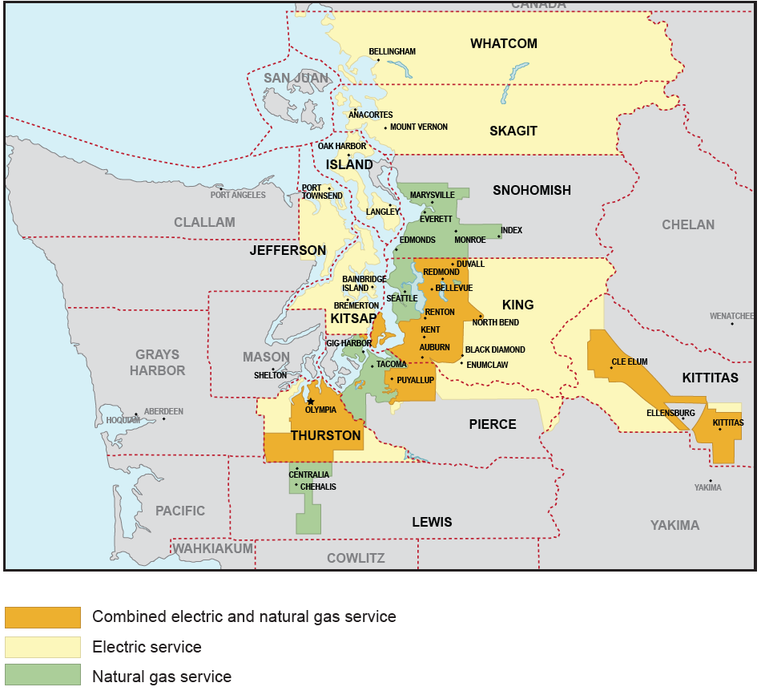
Example 2: Puget Sound Energy
Investor-owned utility
Private monopoly

Slide 7
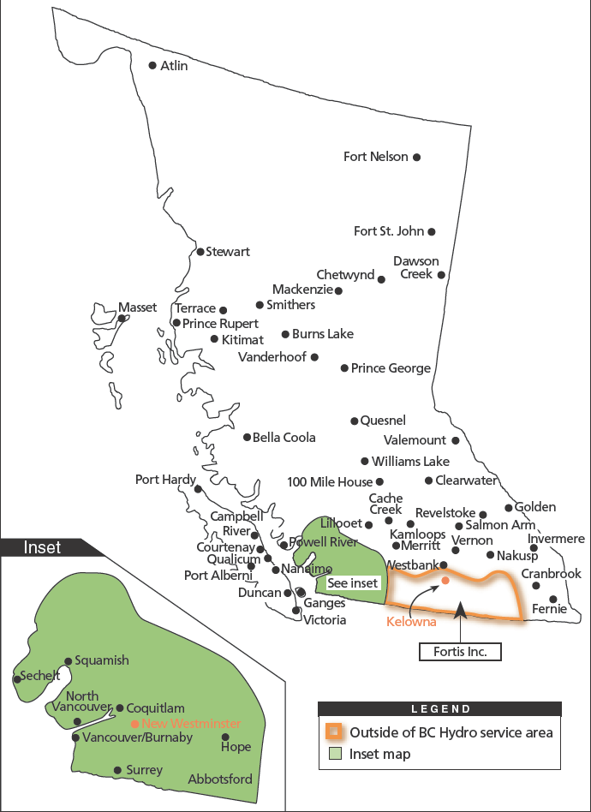
Example 3: BC Hydro
Owned by the Province of British Columbia
Public monopoly

Slide 8
Possible variants on vertical integration
Generation
One entity handles generation and transmission
Other entities handle distribution and retail
Example from the Pacific Northwest:
Generation and transmission:
Bonneville Power Administration (BPA)
Distribution and retail
Municipal utilities
Rural electricity cooperatives
Public utility districts
Example of hybrid:
Seattle City Light is vertically integrated but buys power from BPA
Transmission
Distribution
Retail
Consumer

Slide 9
Types of utilities in the United States
Type |  | Number
Investor-owned Companies |  | 265
Municipal Systems |  | 1,818
Public Power Districts |  | 75
State |  | 68
County Systems |  | 5
Rural Electric Co-Ops |  | 922
U.S. Government |  | 37

Slide 10
Regulation
A private monopoly could abuse its position
It must be regulated by the government
Government-owned utilities operate for the public good
No need for outside regulation
Elect new representatives if we are not satisfied

Slide 11
The “Regulatory Compact”
Agreement between an Investor-Owned Utility (IOU) and a government
IOU receives the right to be the monopoly supplier over a certain territory
IOU accepts that its rates (i.e., what it can charge consumers) will be determined by a regulator
Example: the Washington Utilities and Transportation Commission regulates Puget Sound Energy

Slide 12
Rate of return regulation
Regulator sets the rates so that the IOU can:
Recover its operating cost (fuel, personnel, etc…)
Recover its investment costs (plants, lines, etc…)
Pay a fair rate of return to its investors
A monopoly utility is a low-risk investment
No competition
A bankrupt utility is in nobody’s interest
The rate of return can therefore be low compared to other investments

Slide 13
Monopolies are inefficient
No competition
No need to be efficient to survive
No incentive to be efficient:
Utility earns more if it invests more
High costs passed on to consumers as high prices of electricity
Rates are “higher than they should be”

Slide 14
Could the regulators do better?
Regulation is difficult
Little basis for comparison
Each regulator oversees a small number of utilities
Each utility has a territory with different characteristics
Difficult to evaluate the utilities’ decisions
Regulator does not have as much staff as the utility
“Information imbalance”

Slide 15
Problems with public monopolies
A good government will run its utilities in an efficient and far-sighted manner
This is not always the case
Conflicts can arise between the objectives of the government and the objectives of the utility
Government monopolies are inefficient too!

Slide 16
Things bad governments do…
Keep rates low to please the voters
Utility does not have enough money for investments
Keep rates high and use the surplus money for other programs
This is an economically inefficient form of taxation
Discourages the consumption of electricity
Force the utility to make unnecessary investments to create jobs

Slide 17
Why introduce electricity markets?
Market competition forces companies to make better decisions
Be more efficient
Introduce innovations
Over time this should lead to lower costs to the consumers

Slide 18
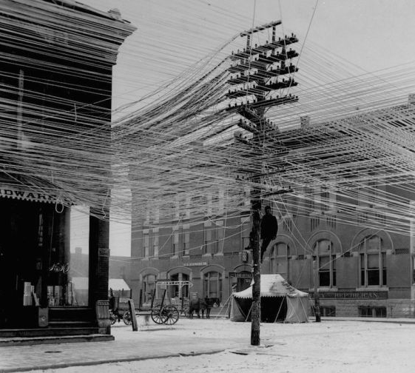
Unbundling
Building competing transmission and distribution networks does not make sense
They are “natural monopolies”
Environmental impact
Networks must remain monopolies
Need to separate the monopoly and non-monopoly activities
“Unbundling” of the vertically integrated utilities

Slide 19
Where can we introduce competition?
Between companies that generate electrical energy
Wholesale market
Between companies that buy electrical energy on the wholesale market and sell it to consumers
Retail market

Slide 20
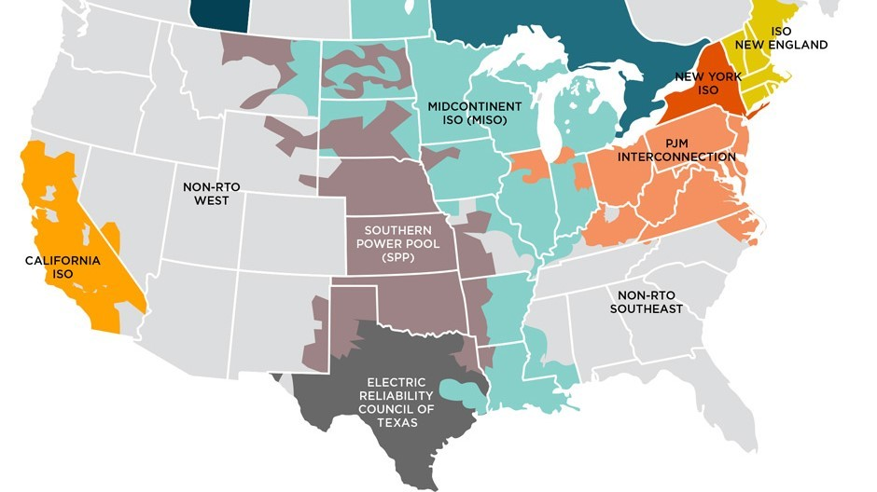
Wholesale electricity markets in the US

Slide 21
Fundamentals of Markets

Slide 22
What are markets?
Locations where buyers and sellers meet to trade goods
Physical or virtual
Venue to execute a transaction
Mechanism for buyers and sellers to collect information
What commodity is being traded?
How much is being offered?
How big is the demand?
Gauge demand and supply for each good
Settle at an economically efficient market equilibrium

Slide 23
Example: market for T-shirts
Supply side
Manufacturing T-shirts
Selling T-shirts
Supply function
Demand side
How many T-shirts shall I buy?
How many T-shirts will people buy?
Demand function
Market equilibrium
Intersection of supply and demand functions

Slide 24
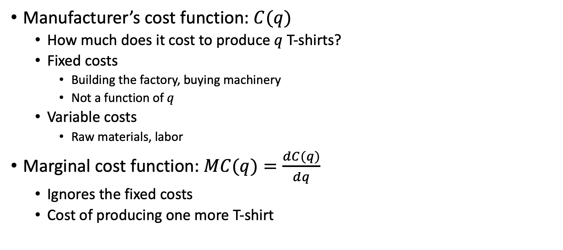
Manufacturer’s perspective
Manufacturer’s cost function: $C(q)$
How much does it cost to produce $q$ T-shirts?
Fixed costs
Building the factory, buying machinery
Not a function of $q$
Variable costs
Raw materials, labor
Marginal cost function: $MC(q)=\frac{dC(q)}{dq}$
Ignores the fixed costs
Cost of producing one more T-shirt

Slide 25
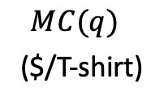

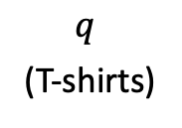
Typical marginal cost function
Increases with $q$ due to extra costs
Overtime pay for workers
Additional maintenance
$MC(q)$
($/T-shirt)
$q$
(T-shirts)

Slide 26
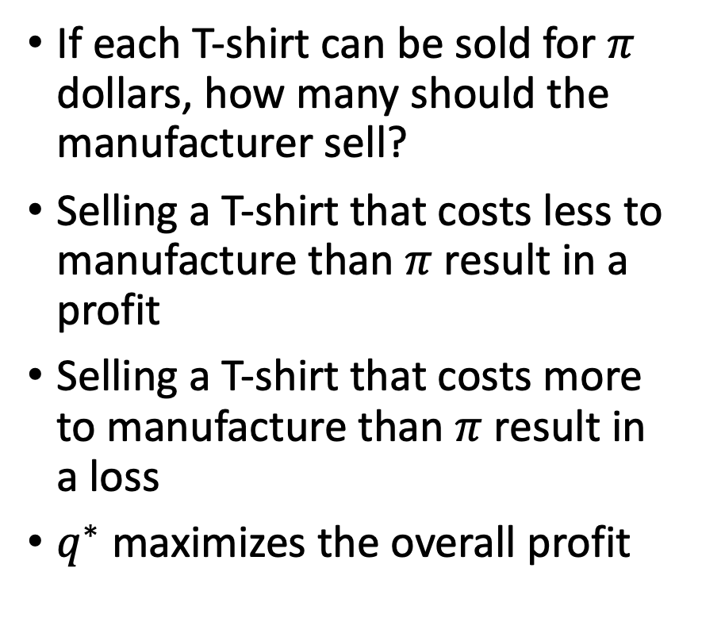


Optimal production level
If each T-shirt can be sold for $π$ dollars, how many should the manufacturer sell?
Selling a T-shirt that costs less to manufacture than $π$ result in a profit
Selling a T-shirt that costs more to manufacture than $π$ result in a loss
$q^{∗}$ maximizes the overall profit
$MC(q)$
($/T-shirt)
$$π$$
$$q^{∗}$$
$q$
(T-shirts)

Slide 27







Inverse supply function
Each supplier comes to the market with its own marginal cost function
Each of these function shows how much it is willing to sell as a function of the price
The inverse supply function is the aggregation of each supplier’s marginal cost function
${MC}_{1} (q_{1})$
${MC}_{2} (q_{2})$
${π=S}^{−1}(q)$
$$π$$
$$q_{1}^{∗}$$
$q_{1}$
$$q_{2}^{∗}$$
$q_{2}$
$$q_{1}^{∗}+q_{2}^{∗}$$
$q$

Slide 28
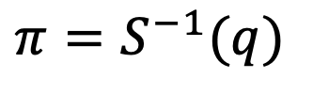
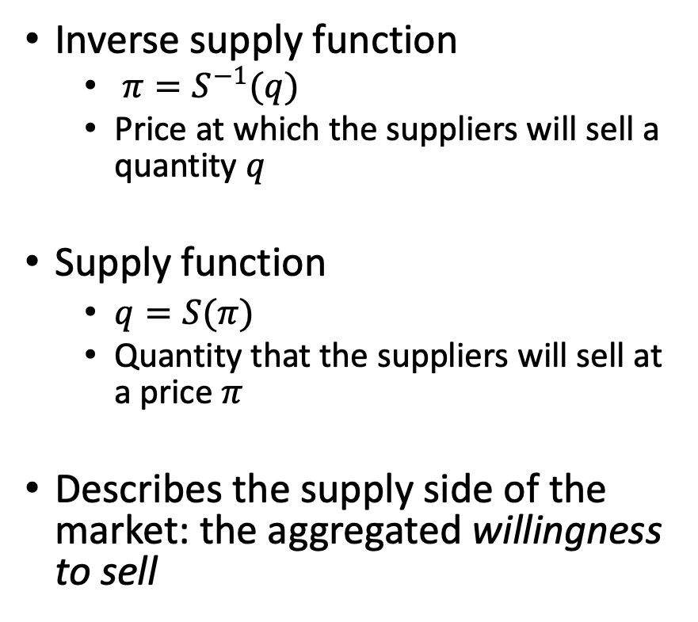

Inverse supply function
Inverse supply function
$π=S^{−1}(q)$
Price at which the suppliers will sell a quantity $q$
Supply function
$q=S(π)$
Quantity that the suppliers will sell at a price $π$
Describes the supply side of the market: the aggregated willingness to sell
${π=S}^{−1}(q)$
$q$

Slide 29
Consumer’s perspective
Shall I buy a T-shirt?
What factors do I consider when making that decision?
How expensive is the T-shirt?
How much enjoyment/utility will I get from this T-shirt?
What else could I buy with this money?
Different people → different decisions
Depending on the price:
Some people will buy a T-shirt, other people will not
Depends on their marginal utility
Marginal utility > price → buy
Marginal utility < price → don’t buy

Slide 30
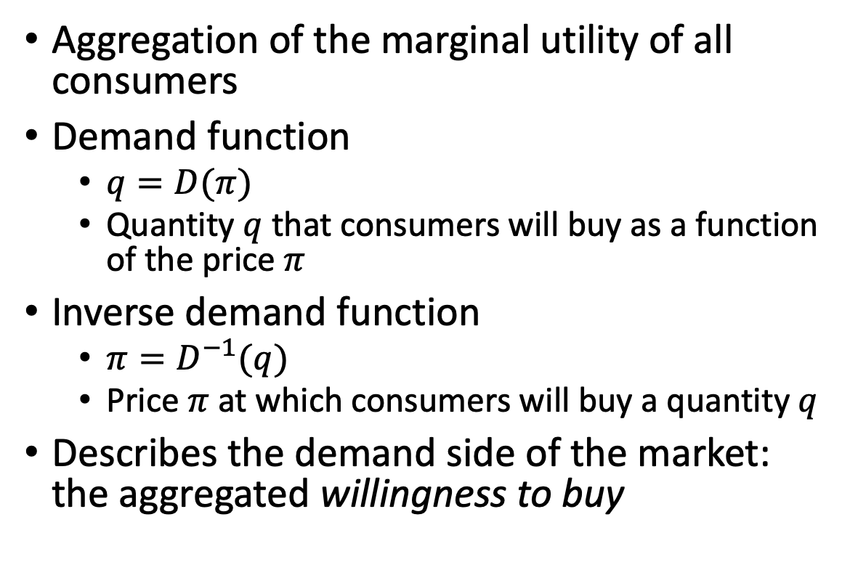
Demand and inverse demand functions
Aggregation of the marginal utility of all consumers
Demand function
$q=D(π)$
Quantity $q$ that consumers will buy as a function of the price $π$
Inverse demand function
${π=D}^{−1}(q)$
Price $π$ at which consumers will buy a quantity $q$
Describes the demand side of the market: the aggregated willingness to buy
${π=D}^{−1}(q)$
$q$

Slide 31
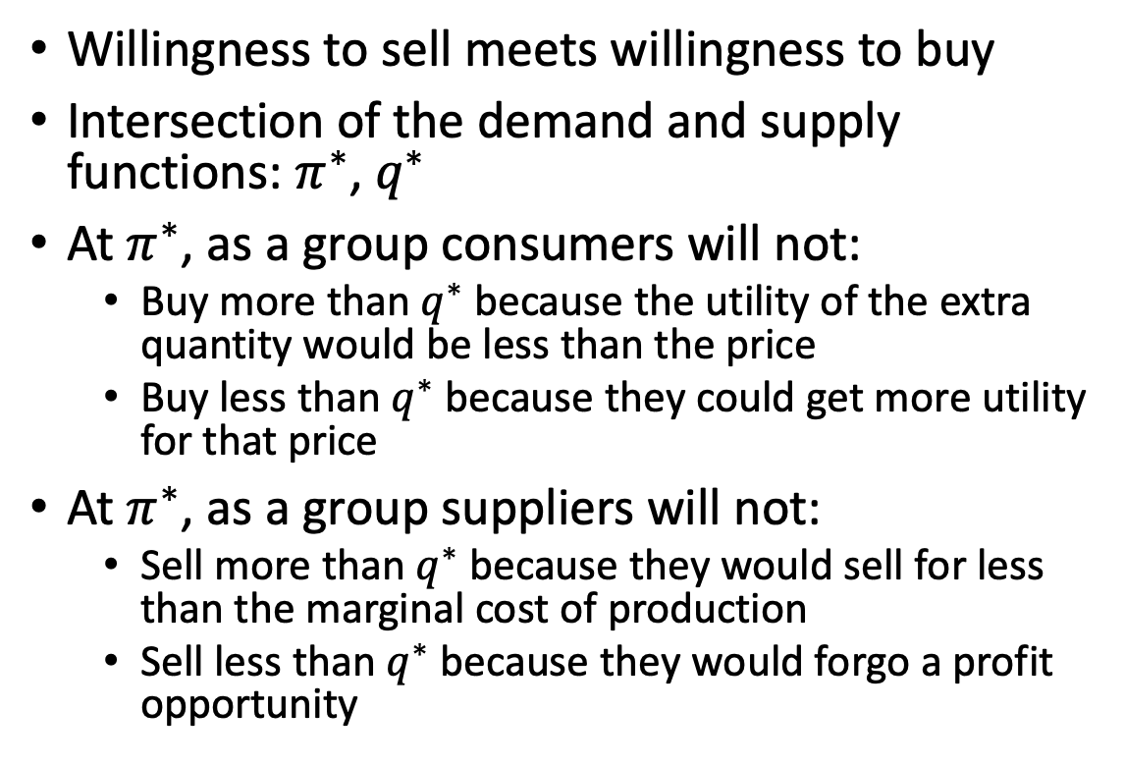


Market equilibrium
Willingness to sell meets willingness to buy
Intersection of the demand and supply functions: $π^{∗}$, $q^{∗}$
At $π^{∗}$, as a group consumers will not:
Buy more than $q^{∗}$ because the utility of the extra quantity would be less than the price
Buy less than $q^{∗}$ because they could get more utility for that price
At $π^{∗}$, as a group suppliers will not:
Sell more than $q^{∗}$ because they would sell for less than the marginal cost of production
Sell less than $q^{∗}$ because they would forgo a profit opportunity
$$π$$
Demand function
Supply function
$π^{∗}$
$$q^{∗}$$
$q$

Slide 32


Market equilibrium
At the market equilibrium:
Market price = suppliers’ marginal cost
Market price = consumers’ marginal utility
Marginal cost = marginal utility
“Marginal pricing”
Valid only if there is perfect competition
Perfect competition requires
Many buyers
Many sellers
If some buyers or sellers have too big a market share, they have market power and can influence the market price
$$π$$
Demand function
Supply function
$π^{∗}$
$$q^{∗}$$
$q$

Slide 33
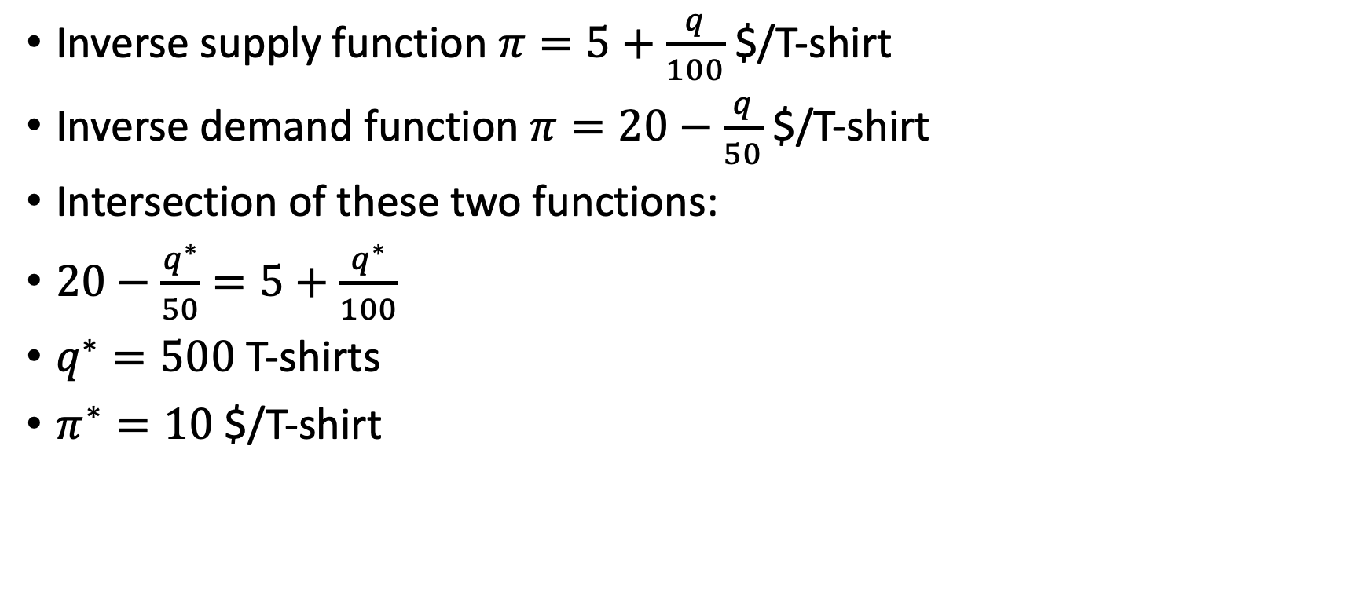
Example 12.1: Market equilibrium
Inverse supply function $π=5+\frac{q}{100}$ $/T-shirt
Inverse demand function $π=20−\frac{q}{50}$ $/T-shirt
Intersection of these two functions:
$20−\frac{q^{∗}}{50}=5+\frac{q^{∗}}{100}$
$q^{∗}=500$ T-shirts
$π^{∗}=10$ $/T-shirt

Slide 34
Structure of a wholesale electricity market
Gencos
Generating companies
Own and operate power plants
Sell energy on the wholesale market
LSEs
Load Serving Entities
Buy energy on the wholesale market
Sell this energy to the consumers in their monopoly service area
Genco 1
Genco 2
Genco N
TSO
Wholesale Market and
Transmission Network
LSE A
LSE B
LSE M
Consumers
Consumers
Consumers

Slide 35
Trading vs. physics
Commodity being traded is energy (MWh)
Power system delivers power (MW) on a continuous basis
Define trading periods
Typically, one hour, 15 minutes, 5 minutes
Trading assumes constant delivery of power over this trading period
Example
Genco sells 20 MW from 2:15 to 2:30 pm
It has sold 5 MWh during this trading period

Slide 36
Trading vs. physics
All MWs get merged in the transmission network
Cannot direct energy sold by a given Genco to a given LSE
All MW are the same (“fungible”)
Keep track of the transactions using meters at both ends

Slide 37
Types of electricity trading
Bilateral trading
Conventional form of trading
Buyer and seller agree on price and quantity without intermediary
However, TSO may limit trades to make sure that they are compatible with the reliable operation of the system
Common form of trading in European markets and the Pacific Northwest
Centralized trading
Specific to electricity markets
TSO takes on the role of market operator
Common form of trading in North America:
PJM, CAISO, ISO-NE, ERCOT, MISO, NYISO, SPP

Slide 38
Centralized trading: supply side
Gencos submit offers to sell for each trading period
Quantity/price pairs
Example: 100 MW at 23 $/MWh
TSO ranks the offers in increasing order of price
→ Creates a supply curve

Slide 39
Example: supply curve in a centralized market
Offers to Sell
Genco | Quantity (MW) | Price ($/MWh)
A | 100 | 0.00
 | 100 | 30.00
 | 50 | 50.00
B | 100 | 15.00
 | 100 | 40.00
 | 50 | 90.00
C | 100 | 0.00
 | 100 | 25.00
 | 50 | 65.00
D | 50 | 10.00
 | 50 | 20.00
 | 100 | 35.00
$/MWh
MW

Slide 40
Centralized trading: demand side
LSEs submit bids to buy for each trading period
Quantity/price pairs
Example: 100 MW at 50 $/MWh
TSO ranks the offers in decreasing order of price
→ Creates a demand curve

Slide 41
Example: demand curve in a centralized market
Bids to Buy
LSE | Quantity (MW) | Price ($/MWh)
P | 100 | 200.00
 | 100 | 175.00
 | 50 | 150.00
Q | 100 | 200.00
 | 50 | 175.00
 | 50 | 10.00
R | 100 | 200.00
 | 100 | 175.00
 | 50 | 15.00
S | 100 | 200.00
 | 50 | 175.00
 | 50 | 5.00
$/MWh
MW

Slide 42
Centralized trading: clearing
TSO identifies the intersection of the supply and demand curves
Determines the market clearing price and the quantity transacted
Genco offers with price less than the market price are accepted
LSE bids with price higher than the market price are accepted
Other bids and offers are rejected
Gencos and LSEs whose bids and offers are accepted are committed to inject or extract from the system the corresponding amount of power during this trading period

Slide 43
Example: centralized market clearing
Accepted bids
$/MWh
Market price: 40 $/MWh
Quantity traded: 750 MW
Accepted offers
MW

Slide 44
Centralized trading: settlement
All energy traded is bought/sold at the market price
All Gencos collect the market price for the accepted offers
All LSEs pay the market price for the accepted bids
Market price reflects the marginal cost of generation

Slide 45
Example: centralized market settlement
$/MWh
Genco | Accepted offers = quantity sold | Revenue
A | 100+100 = 200MW | 200 x 40 = $8,000
B | 100+50 = 150 MW | 150 x 40 = $6,000
C | 100 + 100 = 200 MW | 200 x 40 = $8,000
D | 50 + 50 + 100 = 200 MW | 200 x 40 = $8,000
Total | 750 MW | $30,000
MW

Slide 46
Example: centralized market settlement
$/MWh
LSE | Accepted bids = quantity purchased | Expenditure
P | 100+100+50 = 250MW | 250 x 40 = $10,000
Q | 100+50 = 150 MW | 150 x 40 = $6,000
R | 100 + 100 = 200 MW | 200 x 40 = $8,000
S | 100 + 50 = 150 MW | 150 x 40 = $6,000
Total | 750 MW | $30,000
MW

Slide 47
Bidding in a centralized market
Sufficiently large number of market participant → perfect competition
Gencos optimal bidding strategy: bid marginal cost of generation
Offer accepted at market price
Profit equal to the difference between the market price and the offer price
Offer rejected
Genco avoids producing at a loss
Offer at higher than marginal cost
→ profitable offer risks being rejected
Offer at lower than marginal cost
→ non-profitable offer risks being accepted

Slide 48
Bidding in centralized markets
Less competitive market
Example: demand is high and most of the available generation capacity is needed
Gencos can offer at substantially more than their marginal cost
Try to drive up the market price to recover their fixed costs
Generators that mostly care about producing energy
Nuclear units that cannot shutdown if their bid is not accepted
Renewable generation whose marginal cost is close to zero
Offer at zero
Let the offers of the other gencos set the market price

Slide 49
Example: extreme offers
$/MWh
Less competitive generators that run only when the
demand is high
Generators that bid zero to make sure that they get to produce. Typically nukes and renewables.
MW

Slide 50
Example: demand side bidding
Since loads tend to be inflexible, most demand side will bid high to ensure
that they get selected
$/MWh
Some consumers are flexible and willing to curtail or shift their load
if the price is too high
Some loads are highly flexible and wait for a very low price e.g., battery charging
MW

Slide 51
Replacing the demand curve by a load forecast
Some markets neglect the effect of the price on the demand
The demand curve is then replaced by a vertical line at the forecast value of the load
$/MWh
MW

Slide 52
Variation of the load over a day

Slide 53
Discretized variation of the load over a day
Assume that the load is constant over each one-hour trading period

Slide 54
Market clearing for each hour
Replace the demand curve by the load forecast for each trading hour
Offers from the Gencos are valid for the whole day
Clear the market for each hour
Market price increases with the load
$/MWh
MW

Slide 55
Example: time-varying market prices
$/MWh
Hour | 1 | 2 | 3 | 4 | 5 | 6
Load | 390 | 375 | 300 | 275 | 225 | 300
Hour | 13 | 14 | 15 | 16 | 17 | 18
Load | 810 | 775 | 750 | 750 | 825 | 875
Hour | 7 | 8 | 9 | 10 | 11 | 12
Load | 425 | 550 | 650 | 750 | 775 | 825
Hour | 19 | 20 | 21 | 22 | 23 | 24
Load | 925 | 825 | 750 | 650 | 450 | 425
MW

Slide 56
Example: time-varying market prices
$/MWh
Hour | 1 | 2 | 3 | 4 | 5 | 6
Load | 390 | 375 | 300 | 275 | 225 | 300
Hour | 13 | 14 | 15 | 16 | 17 | 18
Load | 810 | 775 | 750 | 750 | 825 | 875
Hour | 7 | 8 | 9 | 10 | 11 | 12
Load | 425 | 550 | 650 | 750 | 775 | 825
Hour | 19 | 20 | 21 | 22 | 23 | 24
Load | 925 | 825 | 750 | 650 | 450 | 425
Hour

Slide 57
Example: Price-duration curve for ISO-NE in 2022
$/MWh
Percentage of hours

Slide 58
Effect of transmission capacity limits
Assumption so far: supply and demand curves reflect the bids and offers of all the Gencos and LSEs
Market price applied uniformly to all transactions
Problem: pattern of generation and demand may result in violations of operating limits of the transmission network
Must modify the results of the market clearing to remove these violations

Slide 59
Locational marginal pricing
Modify the market clearing to respect transmission constraints
→ Reject some cheaper offers in the “wrong” place
→ Replace them with more expensive offers in the “right” place
Market price depends on the location
Locational marginal pricing

Slide 60
Example: locational marginal pricing
Same generators and same load as in the previous centralized market example
Generators and loads separated in two regions connected by a single transmission line
Western
Eastern
A
B
D
C
225 MW
525 MW

Slide 61
Example: locational marginal pricing
Market clearing from previous example
Ignores transmission network
Violates the 50 MW rating of the transmission line
Western
Eastern
A
200 MW
150 MW
B
175 MW
D
200 MW
200 MW
C
225 MW
525 MW

Slide 62
Example: locational marginal pricing
To remove the overload:
Reduce the generation in the Western region by 125 MW
Increase the generation in the Eastern region by 125 MW
A & D compete to supply 275 MW
B & C compete to supply 475 MW
Western
Eastern
A
200 MW
150 MW
B
175 MW
D
200 MW
200 MW
C
225 MW
525 MW
Western
Eastern
A
B
50 MW
D
C
225 MW
525 MW

Slide 63
Example: locational marginal pricing
To remove the overload:
Reduce the generation in the Western region by 125 MW
Increase the generation in the Eastern region by 125 MW
Western
Eastern
A
200 MW
150 MW
B
175 MW
D
200 MW
200 MW
C
225 MW
525 MW
Western
Eastern
A
175 MW
225 MW
B
50 MW
D
100 MW
250 MW
C
225 MW
525 MW

Slide 64
Example: locational marginal pricing
Western region
Eastern region
$/MWh
$/MWh
MW
MW
Market price in the Western region: 30 $/MWh
Market price in the Eastern region: 90 $/MWh

Slide 65
Locational marginal pricing (LMP)
Generators are paid the LMP at the bus where they are connected
LSEs pay the LMP at the bus where they are connected
Prices will vary depending on which constraints are binding
Example with two zones and one transmission line
→ Easy to calculate the locational marginal prices
Larger, meshed transmission networks
→Solve a linearized optimal power flow
→ Prices are the Lagrange multipliers of the nodal power balance constraints

Slide 66
Examples of locational marginal prices
CAISO
ERCOT
MISO
ISO-NE
NYISO
SPP
PJM

Slide 67
Day-ahead market
Benefits of unit commitment:
Amortize startup costs over enough trading period
Satisfy operating constraints on the generating units
Minimum up- and down-time, ramp rates
Clear the market one day-ahead using a unit commitment

Slide 68
Day-ahead market based on unit commitment
Clear the market on day D-1 for day D
Gencos submit offers for each unit
Offers are valid for all trading periods of day D
Offers must include:
Price/quantity pairs
Startup costs
Operating constraints
LSEs submit their demand curve for each trading period
TSO runs a unit commitment combined with an OPF
Offer prices treated like the marginal costs in a conventional UC
Offer price of the most expensive unit scheduled at each trading period sets the market price

Slide 69
Problem with day-ahead market
Things never turn out as expected…
Error in the load forecast
Some generators do not produce what they were scheduled to produce
Outages of large units, wind and solar generation
How can we maintain the load/generation balance?
Procure some reserve on the day-ahead market
Provide insurance against outages of large units
Implement a balancing market
Economically efficient way of handling the imbalances

Slide 70
Balancing market
5-minute or 15-minute trading period
Operate shortly before real-time
Bids and offers:
Gencos with flexible generating units submit offers
Flexible loads
Storage
TSO determines which bids and offers are needed to keep the system in balance
Most expensive bid or offer sets the real-time price

Slide 71
Two-settlement market
Day-ahead transactions
Settled at the day-ahead price
As if powers produced and consumed were exactly as scheduled
Imbalances settled at the real-time price
Generator produced less than scheduled → pays for the difference at the real-time price
Load consumes more than scheduled → pays for the difference at the real-time price
Generator produced more than scheduled → paid for the difference at the real-time price
Load consumes less than scheduled → paid for the difference at the real-time price

Slide 72
Example: Two-settlement market
Day-ahead market
June 11, hourly trading period 8
Bus Patagonia
Day-ahead price: 23 $/MWh
Genco Blue scheduled to inject 100 MW at that bus
LSE Orange scheduled to extract 50 MW at that bus
Real-time market
June 11, hourly trading period 8
Bus Patagonia
What they actually did:
Trading interval | Blue (MW) | Orange (MW) | RT price ($/MWh)
7:00 – 7:15 | 92 | 50 | 25.00
7:15 – 7:30 | 104 | 46 | 20.00
7:30 – 7:45 | 100 | 54 | 23.00
7:45 – 8:00 | 20 | 42 | 30.00

Slide 73
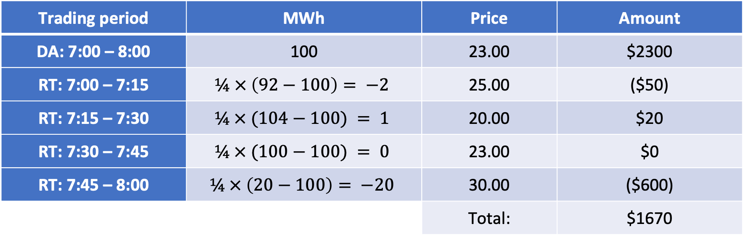
Example: Two-settlement market
Settlement for Genco Blue:
Trading period | MWh | Price | Amount
DA: 7:00 – 8:00 | 100 | 23.00 | $2300
RT: 7:00 – 7:15 | $$¼ × \left(92−100\right)= −2$$ | 25.00 | ($50)
RT: 7:15 – 7:30 | $$¼ × (104−100) = 1$$ | 20.00 | $20
RT: 7:30 – 7:45 | $$¼ × (100−100) = 0$$ | 23.00 | $0
RT: 7:45 – 8:00 | $$¼ × \left(20−100\right)= −20$$ | 30.00 | ($600)
 |  | Total: | $1670
The factors ¼ convert MW imbalances over a 15-minute period to a MWh value.

Slide 74
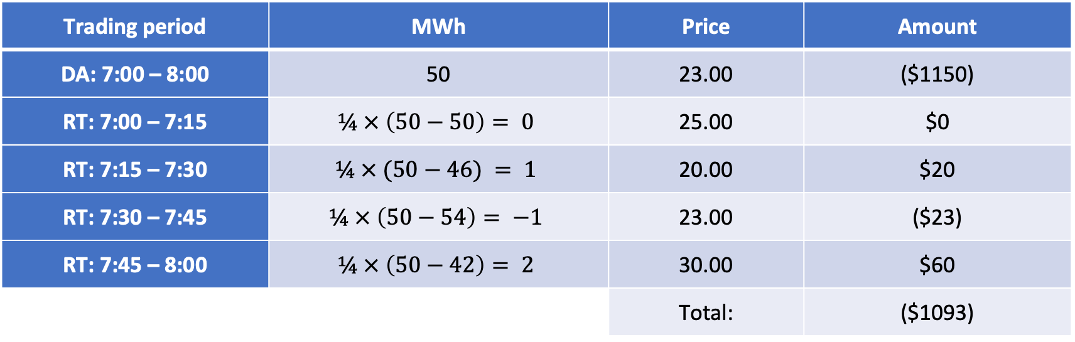
Example: Two-settlement market
Settlement for LSE Orange:
Trading period | MWh | Price | Amount
DA: 7:00 – 8:00 | 50 | 23.00 | ($1150)
RT: 7:00 – 7:15 | $$¼ × \left(50−50\right)= 0$$ | 25.00 | $0
RT: 7:15 – 7:30 | $$¼ × (50−46) = 1$$ | 20.00 | $20
RT: 7:30 – 7:45 | $$¼ × \left(50−54\right)= −1$$ | 23.00 | ($23)
RT: 7:45 – 8:00 | $$¼ × \left(50−42\right)= 2$$ | 30.00 | $60
 |  | Total: | ($1093)
The factors ¼ convert MW imbalances over a 15-minute period to a MWh value.

Slide 75
Ancillary services
TSO responsible for maintaining the stability of the system
Needs resources to do that
In an unbundled system, the TSO does not own these resources
These resources are owned by market participants
These market participants expect to be paid for these resources
→ market for ancillary services

Slide 76
Ancillary services
Contingency reserve
Compensate providers for the opportunity cost of not providing energy
Opportunity for batteries
Frequency control
Constant minor adjustments to power injections/extractions
Zero energy on average
Another opportunity for batteries
Reactive power
Providing reactive power causes losses and reduces opportunity to provide active power
Black start capability
Need to be paid to be available

Slide 77
Retail market
Genco 1
Genco 2
Genco N
TSO
Wholesale Market and
Transmission Network
Retailer A
Retailer B
Retailer M
Discos
Retail Market and
Distribution Networks
Consumer
Consumer
Consumer

